Slide 1
Health Protection Surveillance Centre
Impact of the Pneumococcal Conjugate Vaccines (PCV) on the burden of invasive pneumococcal disease (IPD) in Ireland
Data source: Irish Pneumococcal Reference Laboratory
(Data based on invasive Streptococcus pneumoniae isolates submitted for serotyping)
Date updated: 17th May 2019

Slide 2
Background
IPD is a notifiable disease since January 2004
Clinicians and laboratories are legally obliged to notify all cases to the relevant Department of Public Health
IPD Typing Project commenced in April 2007 and has been instrumental in:
Determining the serotype distribution of IPD isolates prior to the introduction of PCV7 to the infant immunisation schedule
Monitoring the impact of the vaccine on the burden of IPD and on the serotype distribution of isolates
PCV7 vaccine was introduced in September 2008
To the routine infant immunisation schedule at 2, 6 and 12 months
Catch-up for children <2 years of age (born 02/09/2006-30/06/2008)
PCV13 was introduced in December 2010
To the routine infant immunisation schedule at 2, 6 and 12 months for children born in or after October 2010
In December 2016 due to introduction of Men B vaccine, the third dose of PCV was shifted from 12 to 13 months of age for children born after October 1st

Slide 3
Serotypes covered by the Pneumococcal Conjugate Vaccines (PCV) used in Ireland since 2008
PCV7 and PCV13 serotypes are highlighted in red and blue, respectively
Where the term “PCV13-7” is presented in later slides, this relates to the six additional 6 serotypes covered by PCV13 i.e. serotypes 1, 3, 5, 6A, 7F and 19A

Slide 4
Summary of Results Comparing data from Jan-Dec 2018 with same period in 2008, the main findings based on laboratory data from the Irish Pneumococcal Reference Laboratory are:
IPD in Ireland increase by 10% overall
The most dramatic decline was in children <5 years of age
100% decline due to PCV7 serotypes
88% decline due to PCV13-7 serotypes
91% decline due to all serotypes
Overall impact in IPD in ≥5 year olds:
71% decrease due to PCV7 serotypes
9% increase due to PCV13-7 serotypes
4% decrease due to non-PCV13 serotypes
Predominant serotypes in Jan – Dec 2018 were:
8, 19A, 12F

Slide 5
Impact of PCV on the burden of IPD caused by PCV7 vaccine serotypes in <5 year olds
100% reduction in IPD cases, comparing Jan-Dec 2018 with the same period in 2008
Data source: Irish Pneumococcal Reference Laboratory

Slide 6
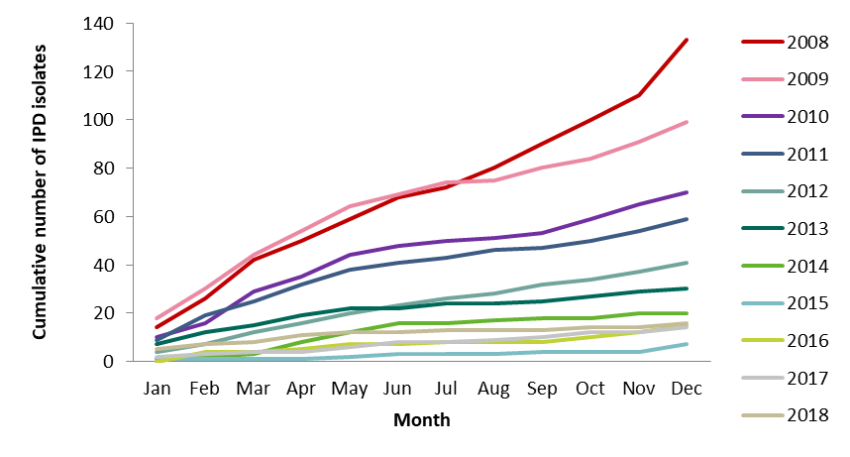
Impact of PCV on the burden of IPD caused by PCV7 vaccine serotypes in ≥5 year olds
88% reduction in IPD cases, comparing Jan-Dec 2018 with the same period in 2008
Data source: Irish Pneumococcal Reference Laboratory

Slide 7
Impact of PCV on the burden of IPD caused by PCV7 vaccine serotypes in all age groups
91% reduction in IPD cases, comparing Jan-Dec 2018 with the same period in 2008
Data source: Irish Pneumococcal Reference Laboratory

Slide 8
Impact of PCV on the burden of IPD caused by PCV13-7 vaccine serotypes in <5 year olds
71% reduction in IPD cases, comparing Jan-Dec 2018 with the same period in 2008
Data source: Irish Pneumococcal Reference Laboratory

Slide 9
Impact of PCV on the burden of IPD caused by PCV13-7 vaccine serotypes in ≥5 year olds
9% increase in IPD cases, comparing Jan-Dec 2018 with the same period in 2008
Data source: Irish Pneumococcal Reference Laboratory

Slide 10
Impact of PCV on the burden of IPD caused by PCV13-7 vaccine serotypes in all age groups
4% reduction in IPD cases, comparing Jan-Dec 2018 with the same period in 2008
Data source: Irish Pneumococcal Reference Laboratory

Slide 11
Impact of PCV on the burden of IPD caused by non-PCV13 vaccine serotypes in <5 year olds
Three fold increase in IPD cases, comparing Jan-Dec 2018 with the same period in 2008
Data source: Irish Pneumococcal Reference Laboratory

Slide 12
Impact of PCV on the burden of IPD caused by non-PCV13 vaccine serotypes in ≥5 year olds
Three fold increase in IPD cases, comparing Jan-Dec 2018 with the same period in 2008
Data source: Irish Pneumococcal Reference Laboratory

Slide 13
Impact of PCV on the burden of IPD caused by non-PCV13 vaccine serotypes in all age groups
Three fold increase in IPD cases, comparing Jan-Dec 2018 with the same period in 2008
Data source: Irish Pneumococcal Reference Laboratory

Slide 14
Impact of PCV on the burden of IPD caused by all serotypes in <5 year olds
61% reduction in IPD cases, comparing Jan-Dec 2018 with the same period in 2008
Data source: Irish Pneumococcal Reference Laboratory

Slide 15
Impact of PCV on the burden of IPD caused by all serotypes in ≥5 year olds
24% increase in IPD cases, comparing Jan-Dec 2018 with the same period in 2008
Data source: Irish Pneumococcal Reference Laboratory

Slide 16
Impact of PCV on the burden of IPD caused by all serotypes in all age groups
10% increase in IPD cases, comparing Jan-Dec 2018 with the same period in 2008
Data source: Irish Pneumococcal Reference Laboratory

Slide 17
Cumulative number of IPD isolates between January – December 2008 and 2018 and percentage changed in burden of IPD since introducing PCV in Ireland
Data Source: National Typing Project
PCV7 serotypes: 4, 6B, 9V, 14, 18C, 19F and 23F;
PCV13-7 serotypes: 1, 3, 5, 6A, 7F, 19A
Non-PCV13 serotypes: All serotypes excluding the 13 serotypes (listed above) in PCV13

Slide 18
Distribution of the S. pneumoniae serotypes in Ireland by age group in Jan - Dec 2018
* Denotes serotypes included in PCV7
*^ Denotes additional serotypes included in PCV13
Data source: Irish Pneumococcal Reference Laboratory

Slide 19
Activities key to the surveillance of IPD in Ireland
Notifications: Clinicians and laboratories should notify all cases of IPD to the relevant Department of Public Health and data are inputted to the national Computerised Infectious Diseases reporting (CIDR) system for notifiable infectious diseases.
Typing: Laboratories should submit all invasive S. pneumoniae isolates to CUH for typing by address: Irish Pneumococcal Reference Laboratory
which is housed with
Irish Meningitis & Sepsis Reference Laboratory,
Temple Street Children’s University Hospital,
Temple Street, Dublin 1
Enhanced surveillance: Departments of Public Health perform enhanced surveillance on cases of IPD notifications and enter these data on CIDR.
Antimicrobial resistance: Laboratories should report data on antimicrobial resistance profiles of invasive S. pneumoniae isolates (from blood and CSF) to the European Antimicrobial Resistance Surveillance System Network (EARS-Net) at HPSC.

Slide 20
Laboratories: Submission of isolates for typing
For details regarding the submission of invasive
Streptococcus pneumoniae isolates for typing, please contact:
Dr Mary Corcoran
Tel.: 01 878 4854
Email: mary.corcoran@cuh.ie
Address:
Irish Pneumococcal Reference Laboratory,
Irish Meningitis & Sepsis Reference Laboratory,
Temple Street Children’s University Hospital,
Temple Street, Dublin 1

Slide 21
Departments of Public Health: IPD surveillance
IPD enhanced surveillance form is available at: http://www.hpsc.ie/A-Z/VaccinePreventable/PneumococcalDisease/SurveillanceForms/
Protocol for the enhanced surveillance of IPD is available at: http://www.hpsc.ie/A-Z/VaccinePreventable/PneumococcalDisease/InformationforHealthProfessionals/

Slide 22
Further Reading
For further details on the surveillance and epidemiology of IPD in Ireland, please see:
Biannual Reports on invasive Streptococcus pneumoniae infection available at
http://www.hpsc.ie/A-Z/VaccinePreventable/PneumococcalDisease/Publications/QuarterlyReportsonInvasivePneumococcalDisease/
Annual Reports on invasive Streptococcus pneumoniae infection available at
https://www.hpsc.ie/a-z/vaccinepreventable/pneumococcaldisease/publications/annualreportsoninvasivepneumococcaldisease/
Articles published in Epi-Insight; available at http://www.hpsc.ie/a-z/vaccinepreventable/pneumococcaldisease/publications/articles/
Posters and Presentations, available at
http://www.hpsc.ie/A-Z/VaccinePreventable/PneumococcalDisease/PostersPresentations/
Quarterly and Annual EARSS Reports available at http://www.hpsc.ie/a-z/microbiologyantimicrobialresistance/europeanantimicrobialresistancesurveillancesystemearss/ears-netdataandreports/

Slide 23
IPD National Typing Project Team
Mary Corcoran¹, Prof Hilary Humphreys²,
Suzanne Cotter³, Robert Cunney^{1, 3},
Stephen Murchan³, Margaret Fitzgerald³,
Meadhbh Hunt³, Breda O’Loughlin³
Jolita Mereckiene³
¹¹Irish Pneumococcal Reference Laboratory, Irish Meningitis & Sepsis Reference Laboratory, Temple Street Children’s University Hospital,
Temple Street, Dublin 1
²Education and Research Centre, Royal College of Surgeons in Ireland and Beaumont Hospital
³Health Protection Surveillance Centre (HPSC), Dublin.

Slide 24
Acknowledgements
The Pneumococcal Typing Project Team wish to thank Mary Corcoran, Martha McElligott and Imelda Vickers who carried out the serotyping, all the laboratories who have participated in the project to date, your support is very much appreciated.
Thanks to all the health care professionals involved in the surveillance of invasive pneumococcal disease in Ireland.

